Slide 1
Module 3: Processing scRNA-Seq with Seurat
NCSU scRNA Workshop, 2024
Bruce Corliss, PhD and Allison Dickey, PhD

Slide 2
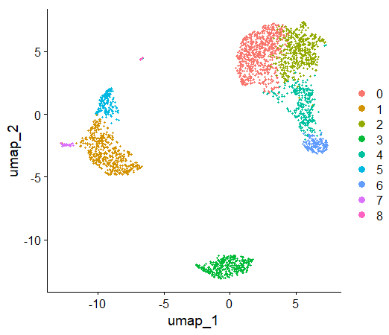
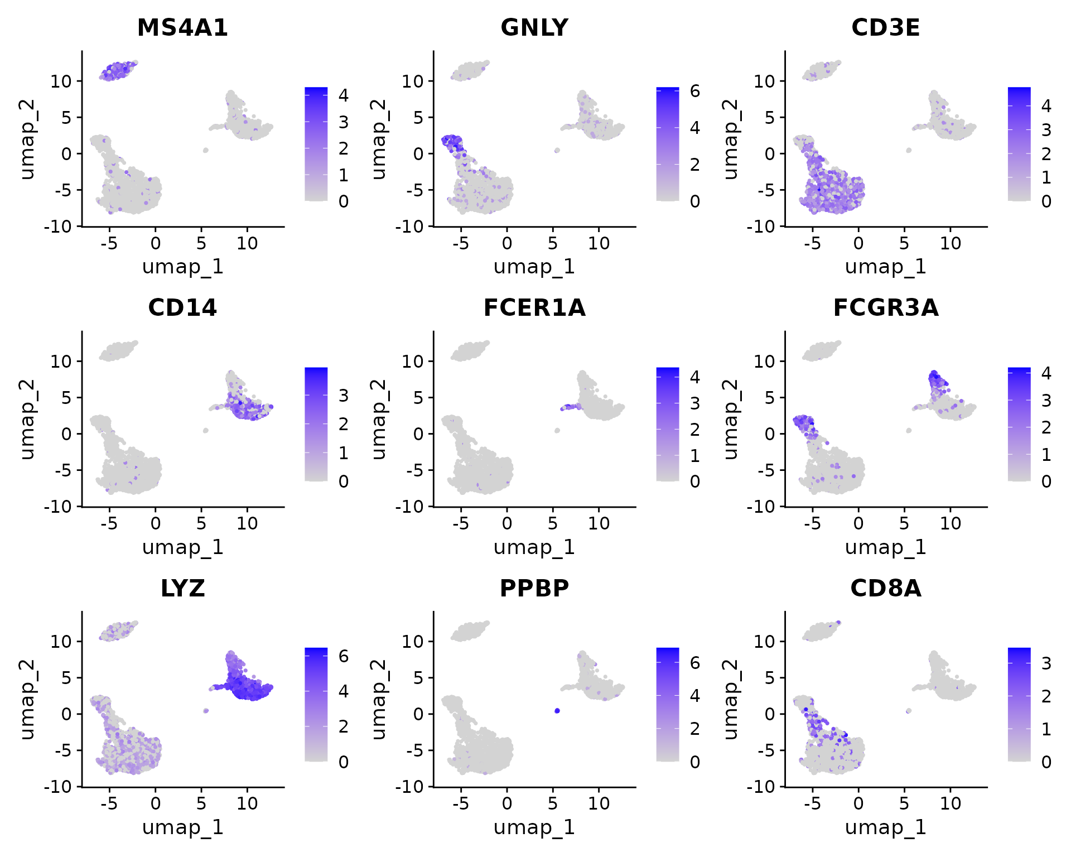
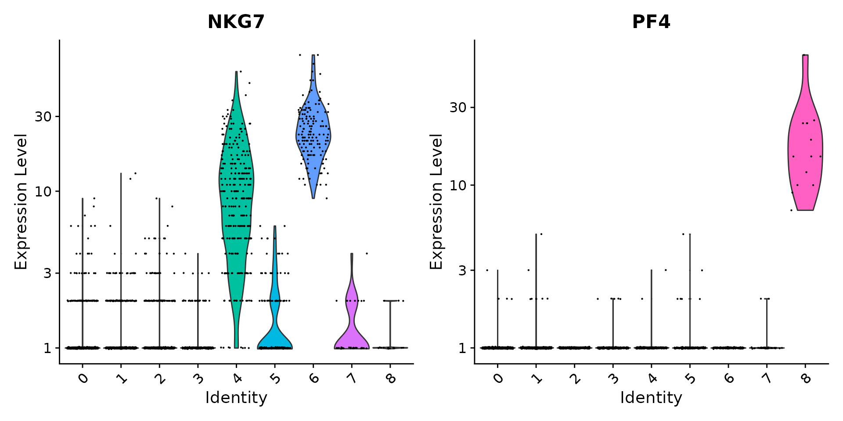
Processing Pipeline Overview
Importation
CreateSeuratObject()
Metadata Curation
Add/correct metadata.
PercentageFeatureSet()
Filtering
Remove low quality measurements.
subset()
Sequence Alignment Output
Normalization
NormalizeData()
FindVariableFeatures()
Gene expression normalization.
Scaling
ScaleData()
Linear Dimensional
Reduction
Reduce dimensions (linear).
RunPCA(), ElbowPlot()
Clustering
Identify cell clusters.
FindNeighbors(), FindClusters()
Nonlinear Dimension Reduction
Reduce dimensions (nonlinear).
Results
Visualize.
RunUMAP(), DimPlot()

Slide 3
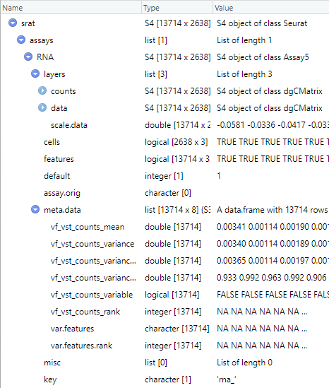
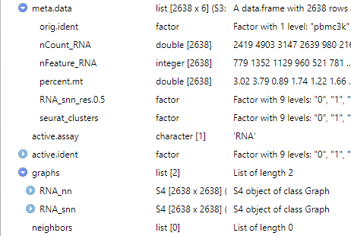
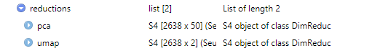
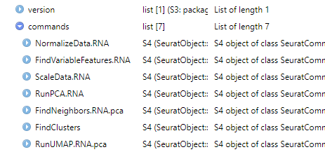
Seurat v5 S4 Class Object
1
Importation
CreateSeuratObject()
2
Metadata Curation
1
PercentageFeatureSet()
3
Filtering
2
subset()
1
7
4
8
4
Normalization
NormalizeData()
5
FindVariableFeatures()
3
5
Scaling
7
ScaleData()
7
Linear Dimensional
Reduction
7
6
6
8
RunPCA(), ElbowPlot()
4
7
Clustering
4
FindNeighbors(), FindClusters()
5
5
6
Nonlinear Dimension Reduction
7
8
7
8
RunUMAP(), DimPlot()
Notes:
https://www.dreamstime.com/stock-illustration-dna-vector-illustration-human-structure-image49975743

Slide 4
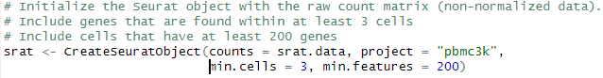
Count Matrix Importation
Importation
An initial minimal filtering can be used on importation
CreateSeuratObject()
Metadata Curation
PercentageFeatureSet()
Filtering
subset()
Cell 1
Cell 2
Cell 3
Cell 4
Cell 5
Cell 6
COUNT
COUNT
COUNT
COUNT
COUNT
COUNT
Normalization
NormalizeData()
FindVariableFeatures()
GENE
GENE
GENE
GENE
GENE
GENE
Scaling
ScaleData()
…
…
…
…
…
…
Linear Dimensional
Reduction
RunPCA(), ElbowPlot()
Cell 1
Cell 2
Cell 3
Cell 4
Clustering
COUNT
COUNT
COUNT
COUNT
FindNeighbors(), FindClusters()
Nonlinear Dimension Reduction
GENE
GENE
GENE
GENE
…
…
…
…
RunUMAP(), DimPlot()
Notes:
https://www.dreamstime.com/stock-illustration-dna-vector-illustration-human-structure-image49975743

Slide 5
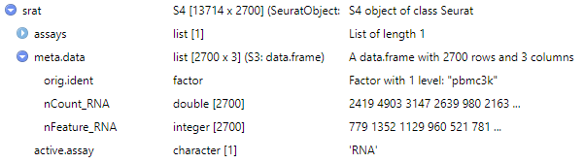
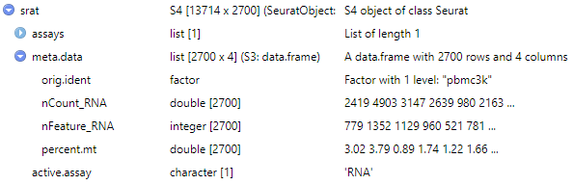
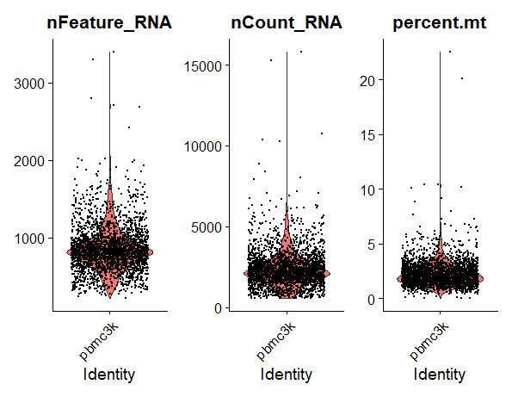
Count Matrix Importation
Importation
CreateSeuratObject()
Typical QC: calculate for fraction of mitochondrial genes
Metadata Curation
PercentageFeatureSet()
Filtering
subset()
Normalization
NormalizeData()
Accessors
FindVariableFeatures()
srat@meta.data$percent.mt
srat[["percent.mt"]]
Scaling
ScaleData()
Some public datasets already perform QC based on MT genes, and all MT genes are removed.
Genes may be labeled at “MT…” or “mt…”, first inspect and confirm what the prefix is.
Linear Dimensional
Reduction
Visualize QC Metrics
RunPCA(), ElbowPlot()
Clustering
FindNeighbors(), FindClusters()
nFeature_RNA: total genes detected in each cell.
nCount_RNA: total molecules detected in each cell.
Percent.mt: fraction of mitochondrial gene.
Nonlinear Dimension Reduction
RunUMAP(), DimPlot()
Notes:
https://www.dreamstime.com/stock-illustration-dna-vector-illustration-human-structure-image49975743

Slide 6
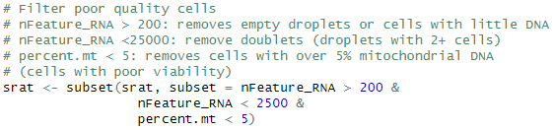
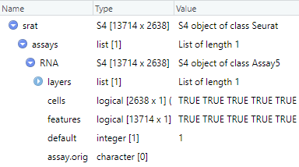
Count Matrix Importation
Importation
CreateSeuratObject()
Remove poor quality cells with the subset() command.
Uses any metadata in Seurat object.
Metadata Curation
PercentageFeatureSet()
Filtering
subset()
Normalization
NormalizeData()
FindVariableFeatures()
Accessors
Scaling
srat[["RNA"]]@cells
srat@assays$RNA@cells
ScaleData()
Linear Dimensional
Reduction
RunPCA(), ElbowPlot()
Clustering
FindNeighbors(), FindClusters()
Nonlinear Dimension Reduction
RunUMAP(), DimPlot()
Notes:
https://www.dreamstime.com/stock-illustration-dna-vector-illustration-human-structure-image49975743

Slide 7
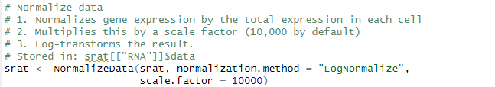
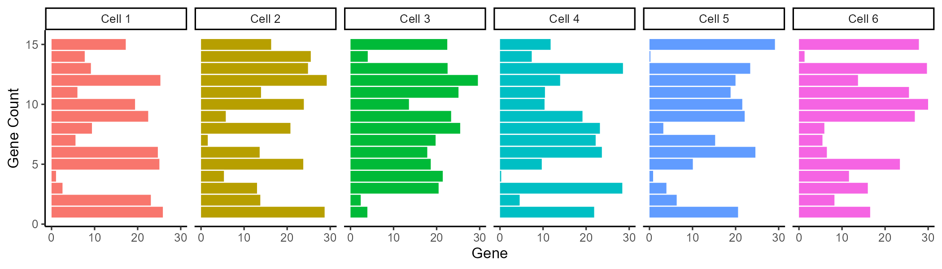
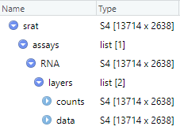
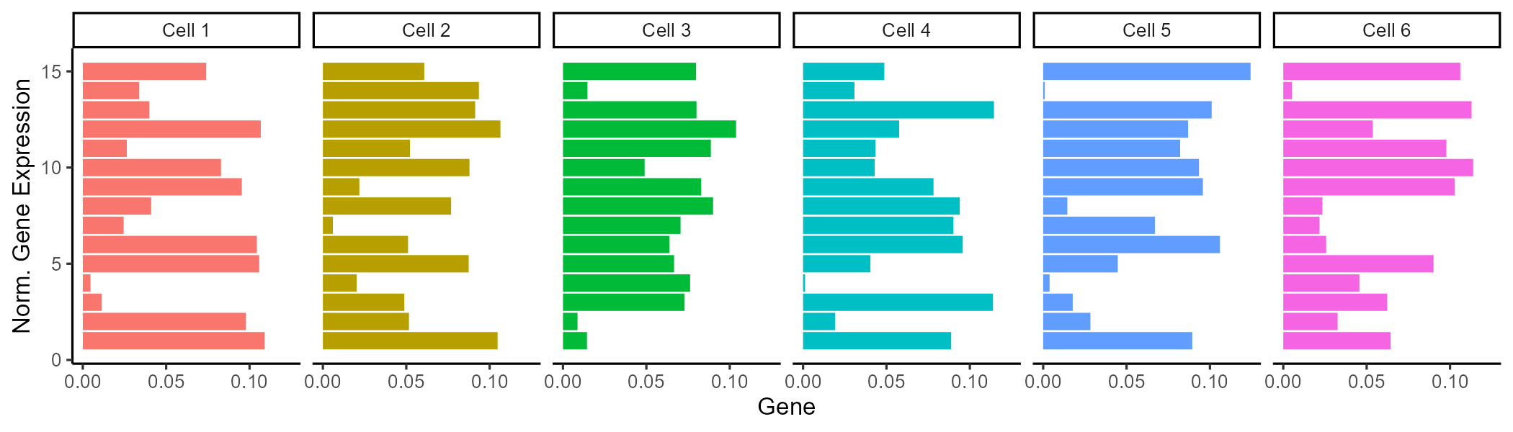
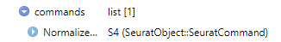
Count Data Normalization
Importation
Normalizing expression ensures expression values across cell are comparable.
CreateSeuratObject()
Metadata Curation
1) Higher raw count values could be from cells with larger library size (total reads from that cell).
2,3) Convention to scale values a useful scale (similar to conventions found in bulk RNA seq).
PercentageFeatureSet()
Filtering
subset()
Normalization
NormalizeData()
FindVariableFeatures()
Scaling
ScaleData()
Linear Dimensional
Reduction
RunPCA(), ElbowPlot()
Clustering
FindNeighbors(), FindClusters()
Nonlinear Dimension Reduction
Accessors
RunUMAP(), DimPlot()
srat[["RNA"]]$data
srat@assays$RNA@data
Notes:
https://www.dreamstime.com/stock-illustration-dna-vector-illustration-human-structure-image49975743

Slide 8
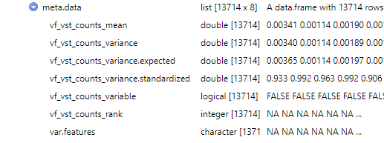
Count Data Normalization: Variable Features
Importation
CreateSeuratObject()
Identify genes with high variation (used for improved clustering)
Metadata Curation
PercentageFeatureSet()
Filtering
subset()
Highly variably expressed genes are used as input points for dimension reduction (statically expressed genes only add noise to the transform).
Normalization
NormalizeData()
FindVariableFeatures()
Instead of just calculating gene expression variance across cells (variance is a noisy random variable), normalization and modeling
Scaling
ScaleData()
Linear Dimensional
Reduction
Accessors
srat[["RNA"]]@meta.data$var.features
srat@assays$RNA@meta.data$var.features
RunPCA(), ElbowPlot()
Clustering
FindNeighbors(), FindClusters()
Nonlinear Dimension Reduction
RunUMAP(), DimPlot()
Notes:
https://www.dreamstime.com/stock-illustration-dna-vector-illustration-human-structure-image49975743

Slide 9
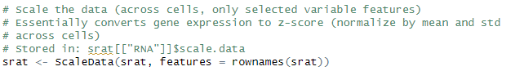
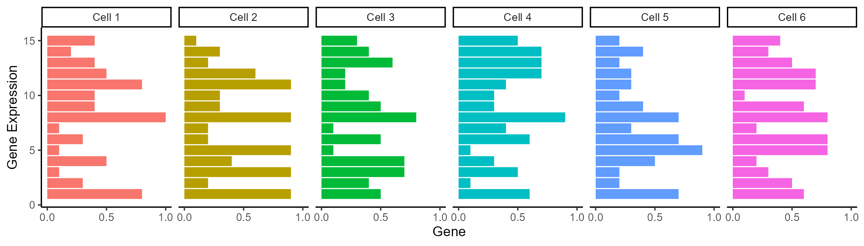
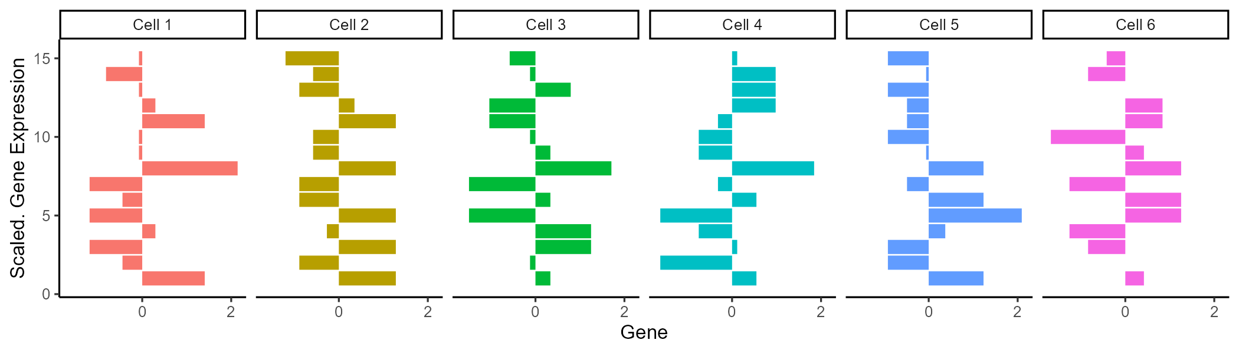
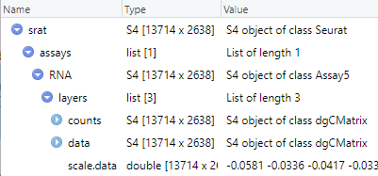
Count Matrix Importation
Importation
Gene expression is scaled (row wise z-scored) to compare across genes
CreateSeuratObject()
Metadata Curation
PercentageFeatureSet()
Centers gene expression by subtracting the average expression for that gene.
Scales expression for each gene by dividing the centered gene expression by their standard deviations.
Filtering
subset()
Normalization
NormalizeData()
FindVariableFeatures()
Z-score = (x-mean(x))/std(x)
Scaling
# of SD from mean
ScaleData()
Linear Dimensional
Reduction
RunPCA(), ElbowPlot()
Clustering
FindNeighbors(), FindClusters()
Nonlinear Dimension Reduction
RunUMAP(), DimPlot()
Notes:
https://www.dreamstime.com/stock-illustration-dna-vector-illustration-human-structure-image49975743

Slide 10
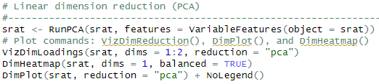
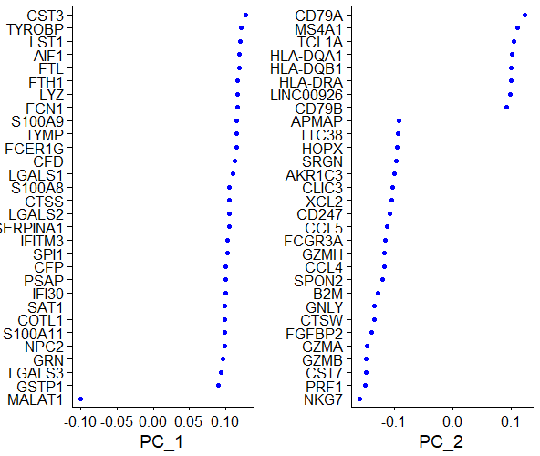
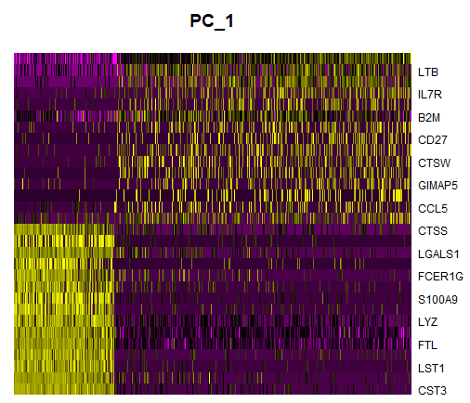
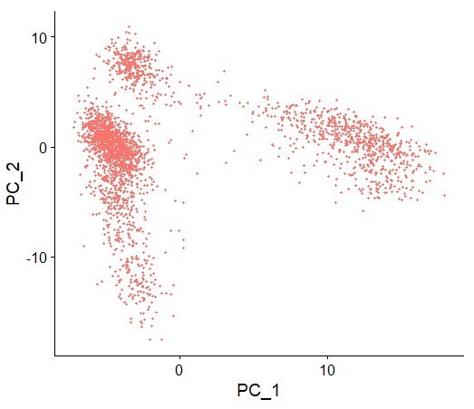
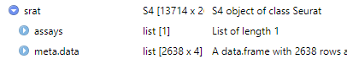
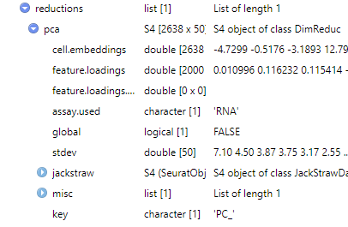
Count Matrix Importation
Importation
CreateSeuratObject()
Metadata Curation
PercentageFeatureSet()
Filtering
subset()
Normalization
NormalizeData()
FindVariableFeatures()
Scaling
ScaleData()
Linear Dimensional
Reduction
RunPCA(), ElbowPlot()
Clustering
1. PCA linearly transforms data onto a new coordinate system such that the principal components (linear combination features) maximizes the variation in the data.
2. Can be used as “anchor points” for nonlinear dimensionality reduction, examine sources of heterogeneity.
FindNeighbors(), FindClusters()
Nonlinear Dimension Reduction
RunUMAP(), DimPlot()
Notes:
https://www.dreamstime.com/stock-illustration-dna-vector-illustration-human-structure-image49975743

Slide 11
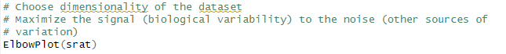
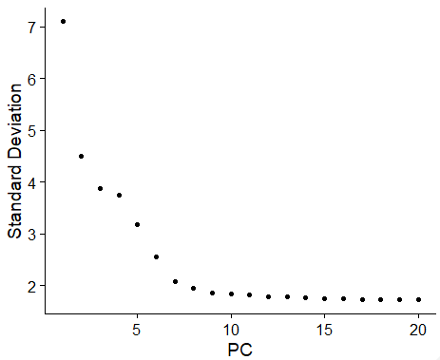
Linear Dimension Reduction
Importation
Select the range of principal component (PC) dimensions that capture the majority of variance.
CreateSeuratObject()
Metadata Curation
PercentageFeatureSet()
Filtering
subset()
For the nonlinear clustering (next steps), we wish to discard as many PCs as possible while still capturing the
variability in the data.
Normalization
NormalizeData()
FindVariableFeatures()
Scaling
Elbow plots display variation captured by each PC, choose a point of diminishing returns for the threshold (dimensions 8-15 would be reasonable for this plot).
ScaleData()
Linear Dimensional
Reduction
RunPCA(), ElbowPlot()
Clustering
Too few PCs: key biological variability in the dataset is discarded.
Too many PCs: biological variation is masked by other sources of variation (signal to noise decreases from other sources of variation).
Nonlinear Dimension Reduction
RunUMAP(), DimPlot()
Notes:
https://www.dreamstime.com/stock-illustration-dna-vector-illustration-human-structure-image49975743

Slide 12
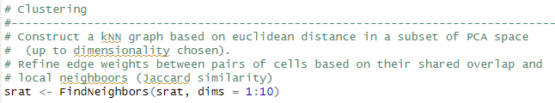
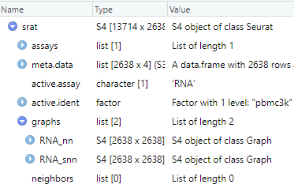
Identifying Neighboring Cells
Importation
CreateSeuratObject()
Before clustering the data, we need to identify the nearest neighbors and score their
similarity in gene expression.
Metadata Curation
PercentageFeatureSet()
Filtering
subset()
Normalization
NormalizeData()
FindVariableFeatures()
Scaling
ScaleData()
Linear Dimensional
Reduction
RunPCA(), ElbowPlot()
Two-tiered graph analysis:
kNN: k nearest neighbor graph
sNN: shared nearest neighbor graph (secondary graph based on kNN, performs better than kNN in high dimesionality)
Clustering
FindNeighbors(), FindClusters()
Nonlinear Dimension Reduction
RunUMAP(), DimPlot()
Notes:
https://www.dreamstime.com/stock-illustration-dna-vector-illustration-human-structure-image49975743

Slide 13
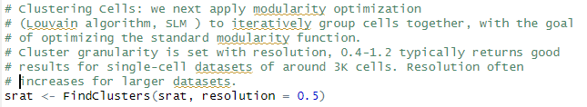
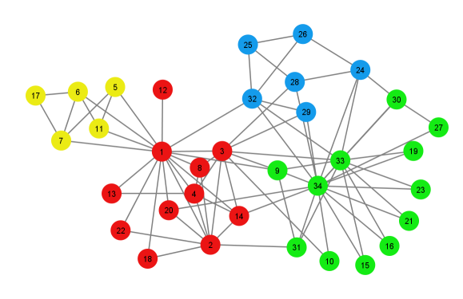
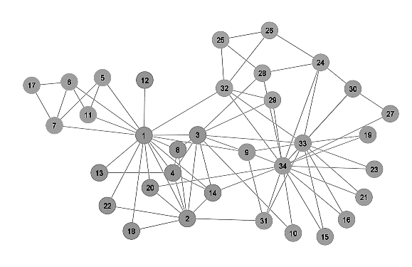
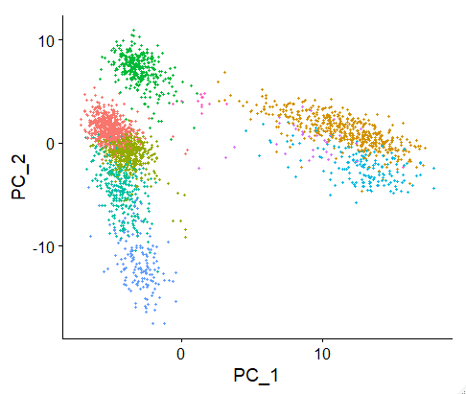
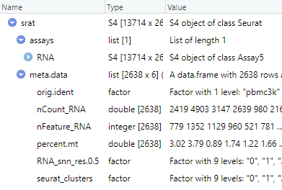
Use Neighbor Graphs to Identify Clusters
Importation
Use kNN and SNN graphs to identify clusters by optimizing a modularity function
CreateSeuratObject()
Metadata Curation
PercentageFeatureSet()
Filtering
subset()
Normalization
Modularity
Function
NormalizeData()
FindVariableFeatures()
Scaling
ScaleData()
Linear Dimensional
Reduction
RunPCA(), ElbowPlot()
Clustering
FindNeighbors(), FindClusters()
Nonlinear Dimension Reduction
RunUMAP(), DimPlot()
Notes:
https://www.dreamstime.com/stock-illustration-dna-vector-illustration-human-structure-image49975743

Slide 14
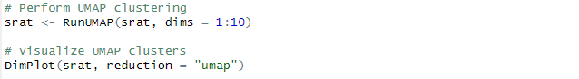
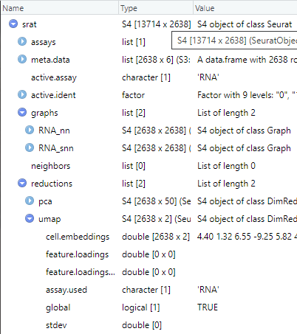
Nonlinear Dimension Reduction
Importation
CreateSeuratObject()
Perform and visualize nonlinear dimension reduction of cluster with the Uniform Manifold Approximation and Projection (UMAP)
Metadata Curation
PercentageFeatureSet()
Filtering
subset()
Normalization
NormalizeData()
FindVariableFeatures()
Scaling
ScaleData()
Linear Dimensional
Reduction
RunPCA(), ElbowPlot()
Clustering
FindNeighbors(), FindClusters()
Nonlinear Dimension Reduction
RunUMAP(), DimPlot()
Notes:
https://www.dreamstime.com/stock-illustration-dna-vector-illustration-human-structure-image49975743

Slide 15
Limitation of Interpreting UMAP Clusters
Hyperparameter Sensitivity
Cluster assignment and global structure are highly sensitive to hyperparameter value. It’s best to run UMAP many times with a variety of hyper parameters.
2. Cluster sizes in a UMAP plot mean nothing
Just as in t-SNE, the size of clusters relative to each other is essentially meaningless. This is because UMAP uses local distances to construct its high-dimensional graph representation.
3. Distances between clusters might not mean anything
While it's true that the global positions of clusters are better preserved in UMAP, the distances between them are not meaningful. Again, this is due to using local distances when constructing the graph.
4. Random noise doesn’t always look random.
Especially at low values of n_neighbors, spurious clustering can be observed.
5. You may need more than one plot
Since the UMAP algorithm is stochastic, different runs with the same hyperparameters can yield different results. Additionally, since the choice of hyperparameters is so important, it can be very useful to run the projection multiple times with various hyperparameters.

Slide 16
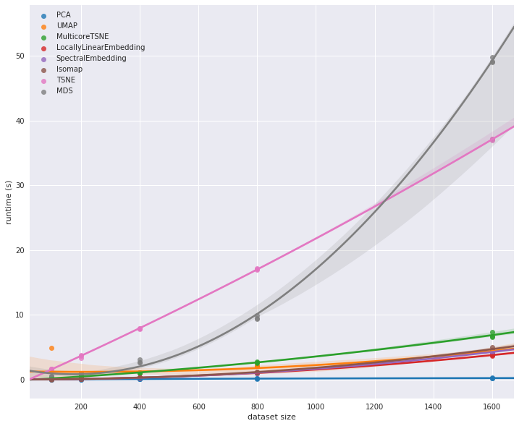
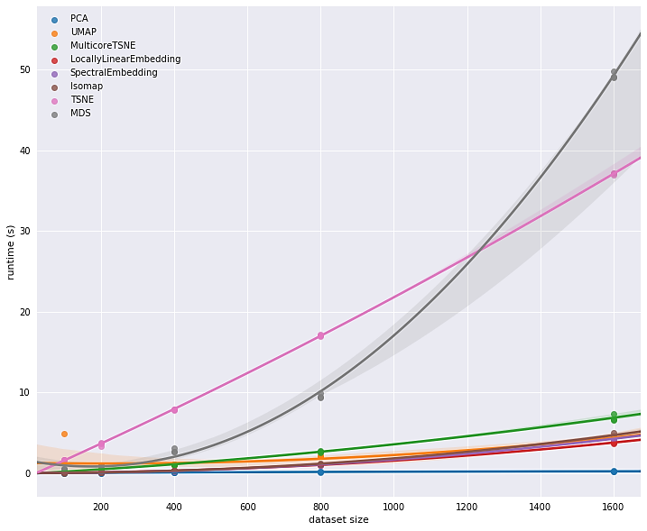
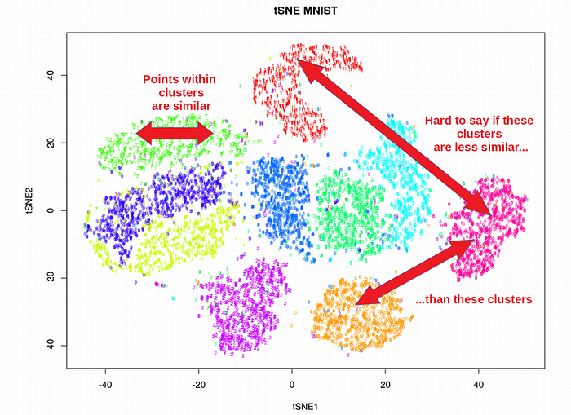
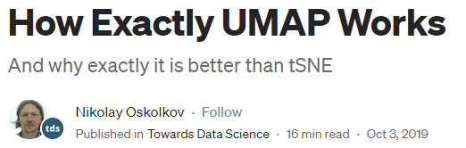
Why use not use tSNE?
tSNE scales poorly with execution time and memory consumption for rapidly increasing sample sizes in scRNAseq.
tSNE does not preserve global data structure.
tSNE can practically only embed into 2 or 3 dimensions, i.e. only for visualization purposes.
tSNE can not work with high-dimensional data directly, Autoencoder or PCA are often used for performing a pre-dimensionality reduction.
https://umap-learn.readthedocs.io/en/latest/benchmarking.html
Time (s)
Dataset size
https://towardsdatascience.com/how-exactly-umap-works-13e3040e1668

Slide 17
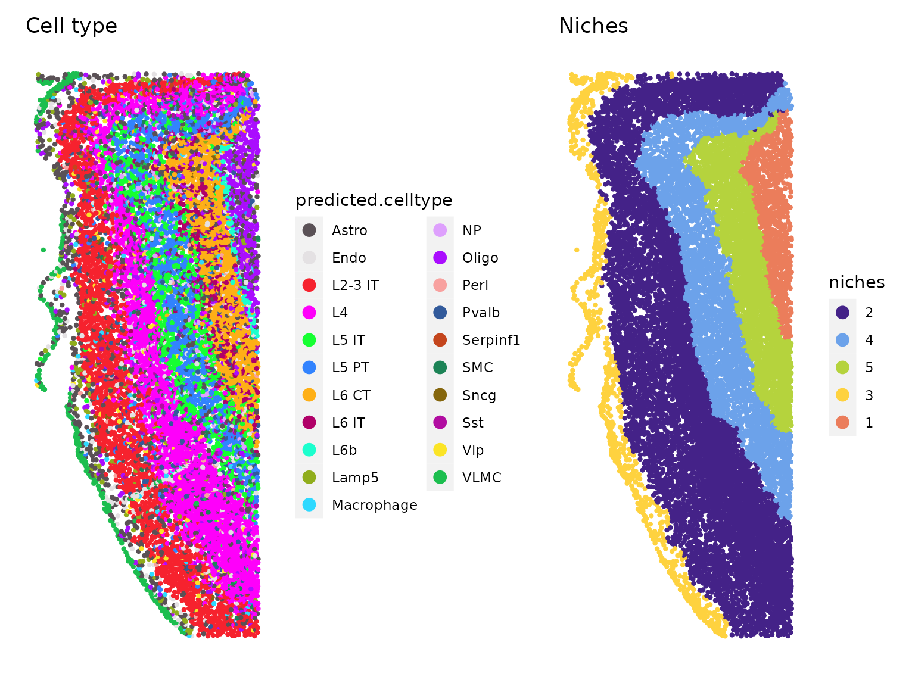
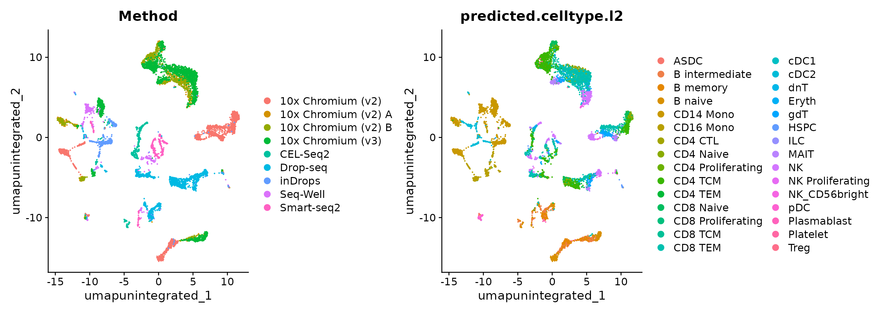
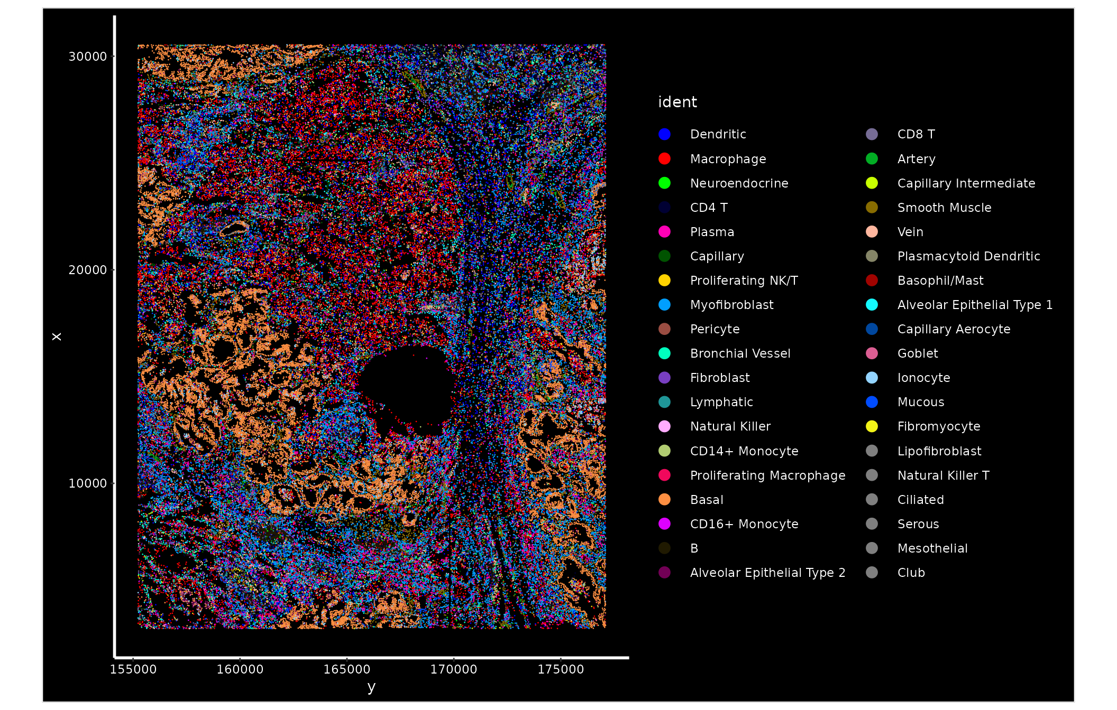
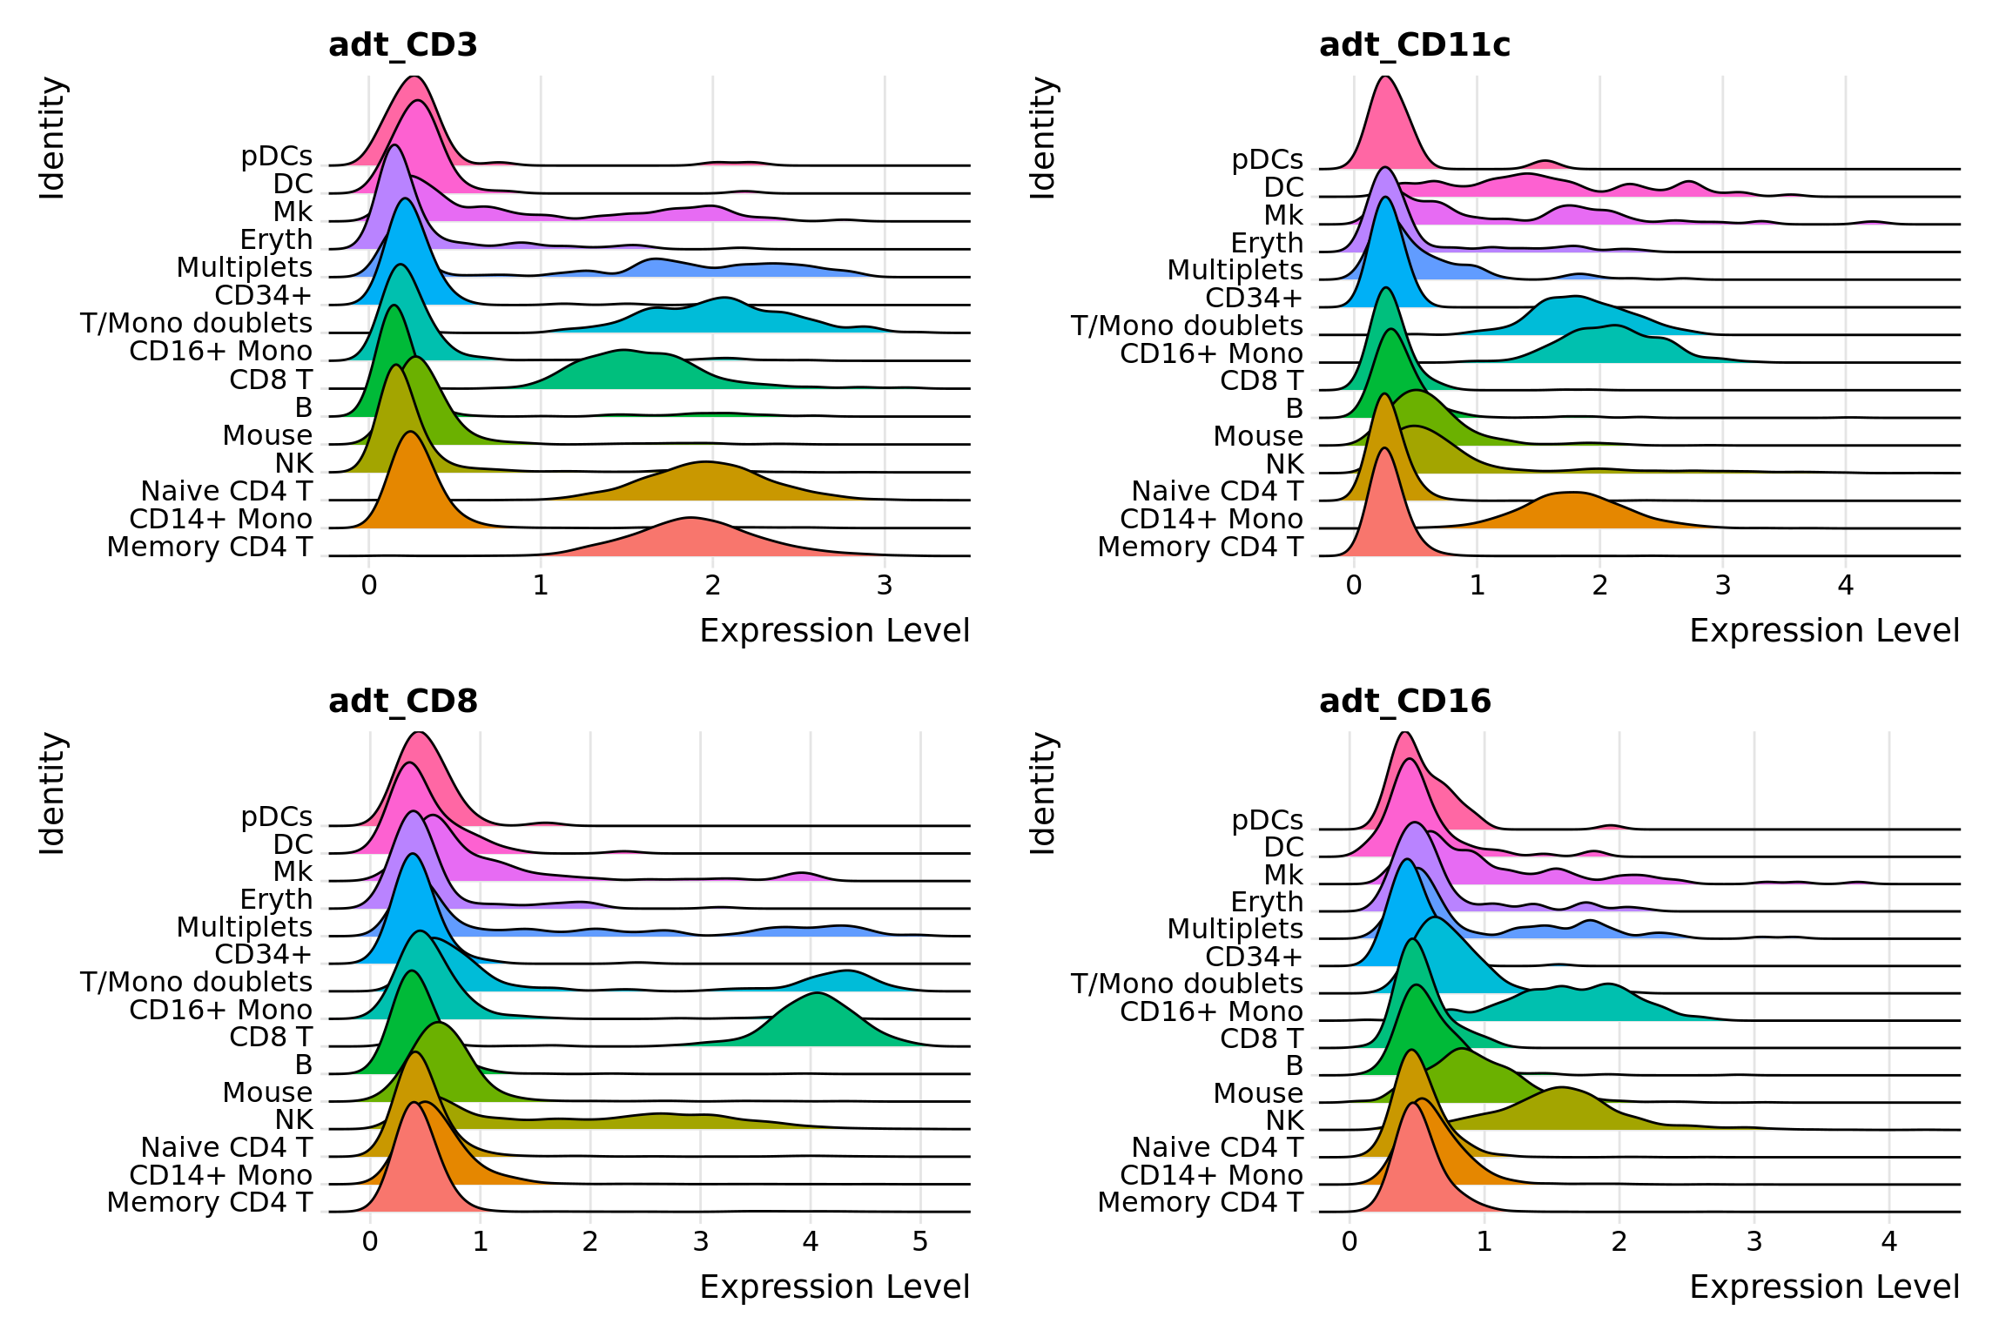
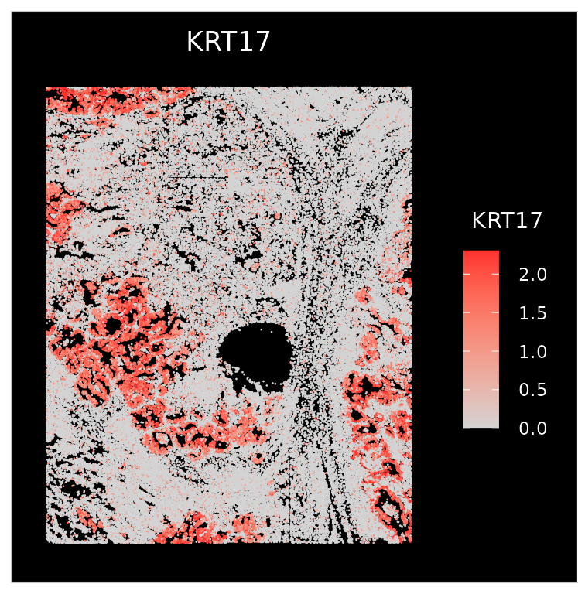
Other Features of Seurat
Analysis of imaging and sequenced based datasets
Integrating multimodal analysis
https://satijalab.org/seurat/articles/seurat5_spatial_vignette_2
https://satijalab.org/seurat/archive/v3.1/multimodal_vignette.html

Slide 18
Questions
Questions?

Slide 19
Seurat Adjustable Parameters
Find Variable
Genes
Count Matrix
Seurat Import
Normalize Data
Min features
Min cells
Max % mito. genes
Normalization method
Scale factor
Selection method
Loess span width
Number of bins
Binning method
Number of Features
Scale Data
Find Neighbors
Find Clusters
Output
Variables to regress
Scale max
Dimension reduction
K-neighbors
Prunning for SNN
Resolution (UMAP)
______. (t-SNE)
Appropriated from:
Schneider, J Transl Genet Genom 2021;5:37-49.
Notes:
https://www.oaepublish.com/articles/jtgg.2020.48

Slide 20
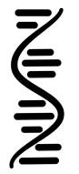

Processing Pipeline Overview
Raw Binary
Sequence
Demultiplexed Reads
Aligned Reads
Filtered feature-
barcode matrices
BCL
FastQ
BAM
SFF
Reference
Genome
VCF
HDF5
GTF
QC
GFF
Seurat
Normalization
and Scaling
Dimensionality
Reduction
Importation
Metadata Curation
Filtering
Marker Identification
Differential Gene
Expression
Biological
Interpretation
Visualization
Clustering
Notes:
https://www.dreamstime.com/stock-illustration-dna-vector-illustration-human-structure-image49975743

